Slide 1
Chapter 22
Object-Oriented
Methodologies

Slide 2

OOA (Object-Oriented Analysis)
OOA (Object-Oriented Analysis) – Defines an information system through ‘objects’ that encapsulate both data and process.
Model the requirements in terms of objects and the services they provide
Grew out of object oriented design
partitions the problem in a different way from structured approaches
poor fit moving from Structured Analysis to Object Oriented Design

Slide 3
Object-oriented analysis (OOA) (Coad and Yourdon 1991)
Published before UML (1990), several versions thus no single definition of OOA exists
Five major activities:
Finding class-&-objects
Identifying structures
Identifying subjects
Defining attributes
Defining services
activities may be iterative, and there is no strict sequence

Slide 4
Cont…
Fnd class-&-objects:
identify object classes that form the core of the application
Identify structures:
organize the classes into generalization (gen-spec) and aggregation (whole-part) hierarchies
Identify subjects:
group the object model into manageable subject areas to create subject layer and structure layer
Define attributes:
identify data elements of each class
Define services of each class:
a service is the operation or processes performed by the object in response to receipt of a message; service charts specify details

Slide 5
OOA
Finding class-&-objects
Increasing the analyst’s understanding of the problem domain
Identifying relevant & stable classes and objects for the application core
--- so called “system responsibilities”, i.e. abstractions to be modeled
Techniques
observations, listening domain experts, reading, gathering previous & system related experience, prototyping

Slide 6
OOA – objects in a class
Student
class-&-object
name
attribute name
services
object is an abstraction of a problem domain
(keep information, i.e. attributes, and interact, i.e. services)
class is a description of one or more objects

Slide 7
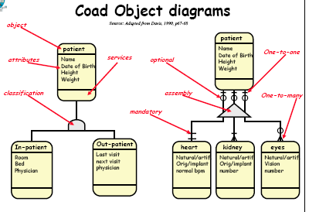

Slide 8
OOA – hints to find relevant class-&-objects
study the structures (second phase of OOA)
look at other systems
look at physical devices to be connected
examine the events that must be remembered & recorded, then the roles that people play
examine relevant physical or geographical locations
danger: identifying too many objects!

Slide 9
OOA – criteria for building entity models
needed remembrance
needed behavior
more than one attribute
more than one object in a class
always applicable, “general” attributes
always applicable, “general” behavior
domain-based requirements
not merely derived results (i.e. avoid something that can be derived/calculated from others)

Slide 10
OOA – identifying structures
organizing classes-&-objects into hierarchies
to enable inheritance to be realized
identifying common objects and separating specific, so called “gen-spec” identification

Slide 11
OOA – gen-spec structures
student
generalization
full-time
student
specialization 1
specialization 2
part-time
student
test it:
is it in the problem domain?
is it within the systems’ responsibilities?
will there be inheritance?
will the specializations meet the “what to consider and challenge” criteria?

Slide 12
OOA – whole-part structure
course
three types to consider
assembly and its constituents
e.g. organization that is composed from various departments
container and its contents
e.g. lecture hall and its seats
collection and its members
e.g. football club and its players
1, 6
a, n
module

Slide 13
OOA – identifying subjects
to reduce the complexity of the model by dividing it into more manageable and understandable subject areas
similar to data-flow-diagram analysis
usually performed bottom-up, then rechecked top-down
to be performed by an appropriate criteria

Slide 14
OOA
defining attributes
defining attributes as in any OO-method
defining services
defines the processing/behavior/methods
identify the services required to change or modify the states
identify ‘algorithmically simple’ services
e.g. create an object “student” launches other services
usually not included in OOA-diagram
identify algorithmically complex services
services concerned with calculations
services concerned with monitoring the external environment
identify services required for processing a message received from another object
presenting them either in English, or in a program flow-chart

Slide 15
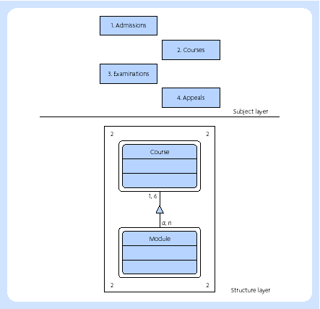
Subject and structure layers

Slide 16
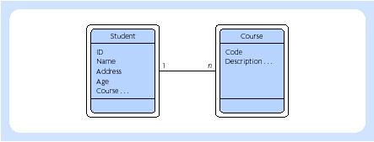
Defining attributes

Slide 17
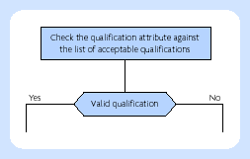
Service chart

Slide 18
Shortcomings of methods Jacobson (2000)
They are paper products, typically frozen in a book
They are rarely tried or tested in real projects (before publication)
They are simple introductions (they are insufficient for use in real, commercial development projects)
They focus on developing new systems and have little to say concerning evolving development or maintenance
They are rich in notations but lack semantics

Slide 19
Rational Unified Process – RUP
projects fail because
ad hoc requirements management, ambiguous and imprecise communication, brittle architecture (architecture that does not work properly in stress), overwhelming complexity, undetected inconsistencies in requirements, designs, and implementations, insufficient testing, subjective assessment of project status, failure to attack risks, uncontrolled change propagation, insufficient automation
to solve these, or at lease consider them properly, would produce good software/systems

Slide 20
RUP (Rational Unified Process)
RUP (Rational Unified Process) – Based on the Unified Modelling Language (UML) RUP captures the same object-oriented theme as OOA. RUP describes how to develop a system using UML as the basis for expressing the system models. The RUP methodology follows a familiar pattern of requirements analysis, design, implementation, test and deployment.

Slide 21
RUP – an overview
developed by 1998/2000 by Jacobson
UML is not enough, but a need for a methodology, i.e. how to use UML, exists
use-case driven, architecture-centric, iterative and incremental process
four phases
inception
elaboration
construction
transition
each having one or more iterations

Slide 22
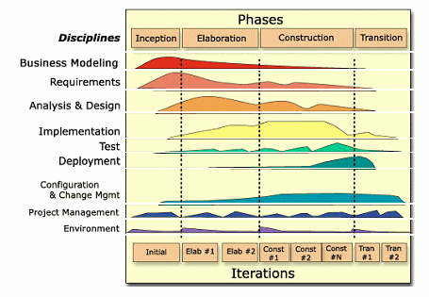
RUP process structure

Slide 23
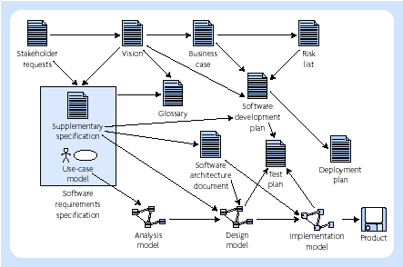
Major artifacts of RUP

Slide 24

End of Chapter 22
Thank
You for Your
Attention

